Slide 1
English in Year 2

Slide 2


What does the English curriculum consist of?
Reading
Writing
Spelling
Handwriting
Grammar

Slide 3

Reading
In Y2 the children will be using the sounds and words that they have learnt in YR and Y1 to read longer and unfamiliar books.
They will be reading more fluently and relying less on sounding out words.
They will also be beginning to read with expression.
Their reading will become more independent and they will be selecting their own books, some of which will be longer.

Slide 4
Reading
Secure at phase 6 phonics.
Reads for pleasure and to gather information.
Reads ahead to help with fluency and expression.
Comments on plat, setting and characters in familiar and unfamiliar stories.
Recounts main themes and events.
Comments on structure of the text.
Use commas, question marks and exclamation marks to vary expression.
Reads aloud with expression and intonation.
Recognise
  Speech marks
  Contractions e.g. I’m, it’s, he’s etc.
Identify past/present tense.
Use content and index to locate information.
Choose a wide range of books independently and give reasons for their choices.

Slide 5
How you can help at home - reading
Read with your child 5 times a week at home and ask questions about the books your child is reading. Please write in the reading diary so that we know your child has read to you.
Talk about the characters, the setting and get them to predict what might happen next.
Ask questions about the words /phrases used by the author.
Make links between books of the same theme and the same author. Similarities? Differences?
Read to your child as much as you can.
Let your child see you reading (and enjoying it!)

Slide 6
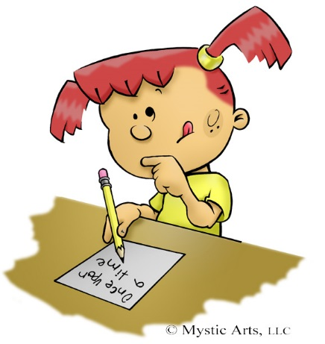
Writing
The children will follow a ‘learning journey’ which maps out the activities in a unit of work during their English lessons in both Y1 and Y2. These units usually last 2-3 weeks.
The children are expected to work with increasing independence, using a variety of resources to support them. Resources include working walls, word cards and spelling books.
They will be expected to work more quickly and write for extended periods in Y2.
Their work will become more accurate and will use a wider vocabulary and more ambitious word choices.

Slide 7
Writing
Write different kinds of sentence: statement, question, exclamation, command.
Use expanded noun phrases to add description and specification.
Write using subordination (when, if, but, because).
Correct and consistent use of present tense & past tense.
Correct use of verb tenses.
Correct & consistent use of:
    Finger spaces
    Capital letters
    Full stops
    Question marks
    Exclamation marks
    Commas in a list
    Apostrophe (omission)
    Introduction of speech marks
Write under headings.
Evidence of diagonal and horizontal strokes to join handwriting.
Spell all high frequency words correctly.
Accurately spell other words, using phonics and knowledge of root words.

Slide 8
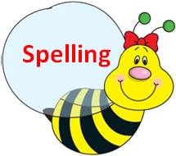
Spellings
Weekly spellings continue to come home on Thursday to be tested the following Wednesday. This will start later in the term.
There is a list of ‘common exception words’ for Year 2. These are a list of words that the children need to be able to spell by the end of Year 2.

Slide 9
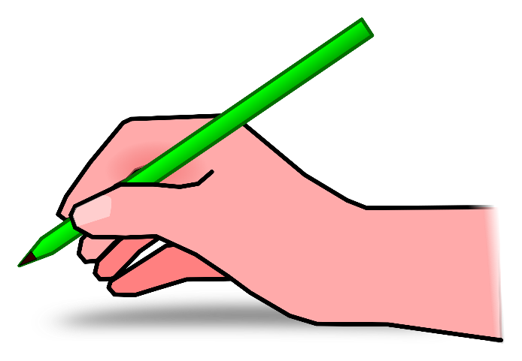
Handwriting
We follow a handwriting scheme where the children print the letters. No cursive letters with lead ins and outs.
We have specific handwriting sessions where correct letter formation is taught.
They will begin to join their letters in Year 2.

Slide 10

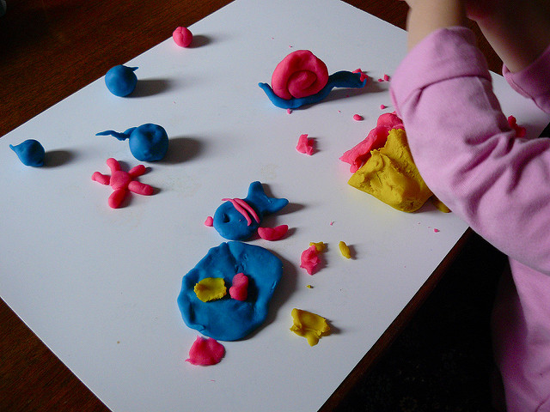
How you can help at home - handwriting
Playdough – rolling, squeezing, stretching etc
Bead threading – making pasta necklaces / bracelets
Cutting
Drawing and colouring
Practising letter formation
Opportunities for writing e.g. invitations, birthday/Christmas cards, letters to friends and family, diaries of what they did at the weekend, etc.

Slide 11

Grammar
Grammar is the system of a language. It can also be described as the ‘rules’ of a language.
In Year 2 it builds on what has been taught in Year 1 and is about knowing what part of speech specific words are:
Adverbs – these describe how or when an adjective is done e.g. yesterday we went swimming, spoke quietly or quickly ran
Coordinating conjunctions – joins words or phrases e.g. for, and, nor, but, or, yet, so
Subordinating conjunctions - joins words or phrases e.g. when , that, if, because
Think of conjunctions as gluing words – they glue words, phrases and clauses together.

