Slide 1

THE RIGHTS-RESPECTING
SCHOOLS AWARD
We are aiming to become a level one rights respecting school.

Slide 2
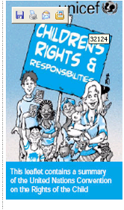
WHAT IS A RIGHTS RESPECTING SCHOOL
LIKE?
The earlier we start the better…
“What does everyone need to grow up safe and well?”
SURVIVAL
PROTECTION
DEVELOPMENT
PARTICIPATION
Notes:
Everyone knows about and values the UN Convention on the Rights of the Child.
That the UN Convention on the Rights of the Child is a charter of rights for all the world’s children up to the age of eighteen.
They can be grouped under 4 headings. NB
Art 6, 19, 29, 12. Art 42 is key. UNICEF is seeking to demonstrate that the RRSA is the way to really do what Art 42 says and that it it makes a difference to children’s achievement under the ECM criteria. For the UK government’s Every Child Matters agenda see: http://www.everychildmatters.gov.uk/children/

Slide 3
...it is where young people gain self-esteem by learning about the rights they have from birth and build from there
I learn about my rights
I feel included
My self-esteem rises
I can begin to think about others and their rights
I learn to negotiate
My language and thinking skills are extended
Notes:
Starting with rights makes all children feel included.
The vulnerable and abused are given an alternative code for living to the brutal one they have been brought up with. They find this empowering.
They can then begin to consider responsibilities, including their own (but starting with adults, e.g. health, safety, education…
Show the links between each step. The consequence is respect.

Slide 4
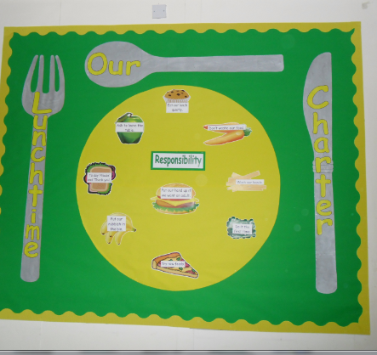
Where children learn...
The difference between wants and needs
That Needs = Rights
That my rights are also your rights i.e. we now learn we have a responsibility.
Learning about the CRC through lunchtime and classroom charters. Displays serve as useful reminders
Notes:
They learn exactly what there rights are…they also learn what their rights are NOT

Slide 5
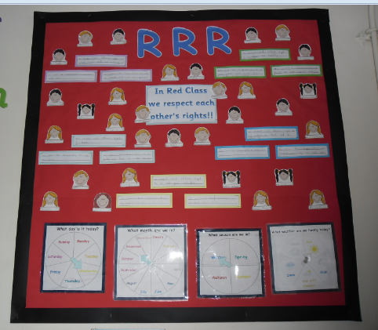
It’s a school where...
.
Everyone learns to use the language of rights, respect and responsibility
Adults and young people model rights-respecting behaviour and language
Young people draw up a charter for their class based
on the CRC. They respect the charter because
they have a sense of ownership
Notes:
Go into the importance of language / concepts developed, especially through role play, in empowering children to negotiate with each other and actively participate in the life of the school, including challenging rights-abusing behaviour (i.e. traditional: bad behaviour).
e.g. “You do not have the right to stop me playing”. Child is empowered to challenge rights-abusing behaviour
“I as a teacher / parent have the responsibility to do what is in your / other children’s best interest…can we discuss what that is…?”

Slide 6
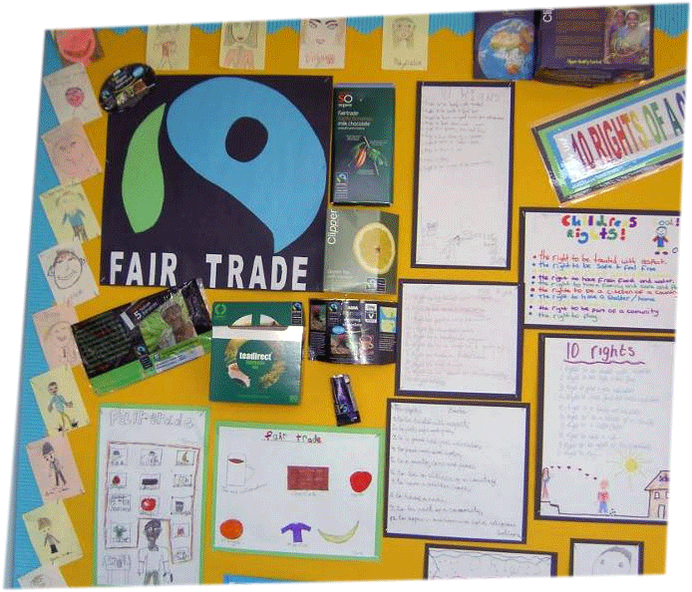
...where children become active global citizens
Universality of human rights
Identity
Challenge injustice, inequality and poverty in the world
Notes:
When children learn about their CRC rights and responsibilities they more readily understand inequality as a denial of rights of others and a matter of injustice. They are more ready to campaign for fair trade products at school and at home.

Slide 7


