Slide 1

An Introduction to Neurodiversity
Kempshott Infant School
2023

Slide 2
Content of this presentation:
What is neurodiversity?
Communication
Behaviour
Masking
Energy levels
Autism

Slide 3


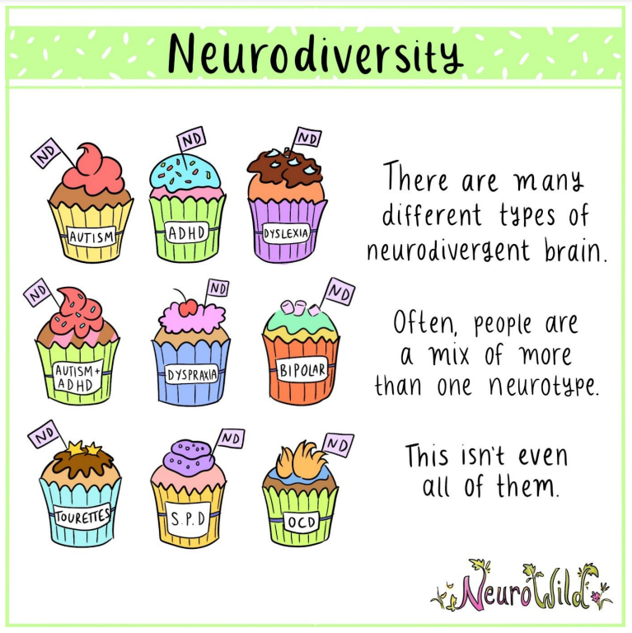
What is your understanding of neurodiversity?
https://youtu.be/j4stO8fTujE
Notes:
Introduce the idea of neurodiversity as being a variation from neurotypical.

Slide 4
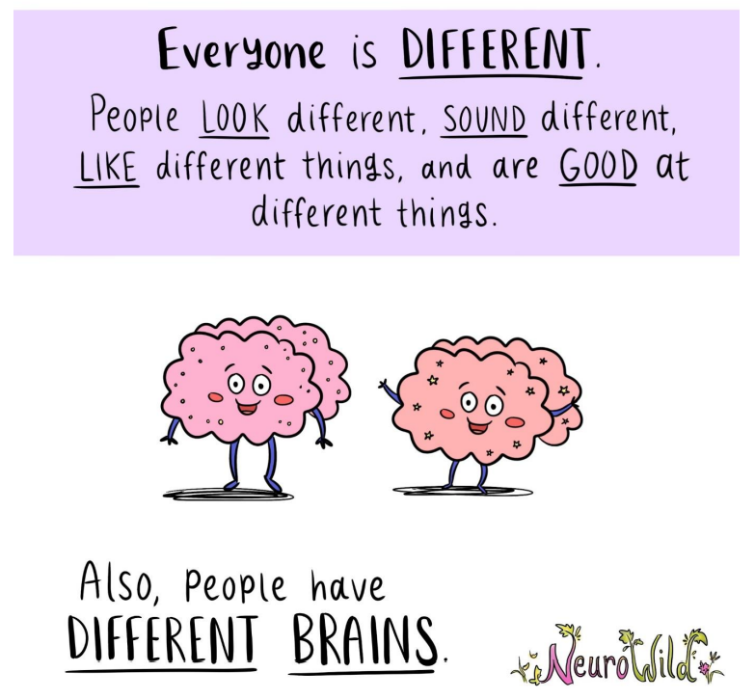
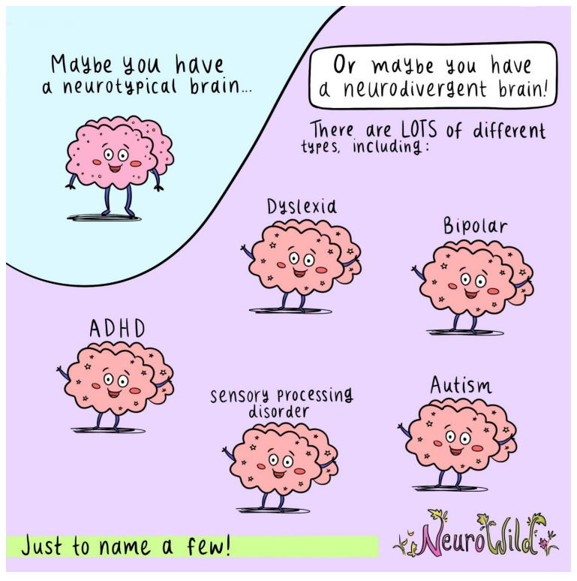
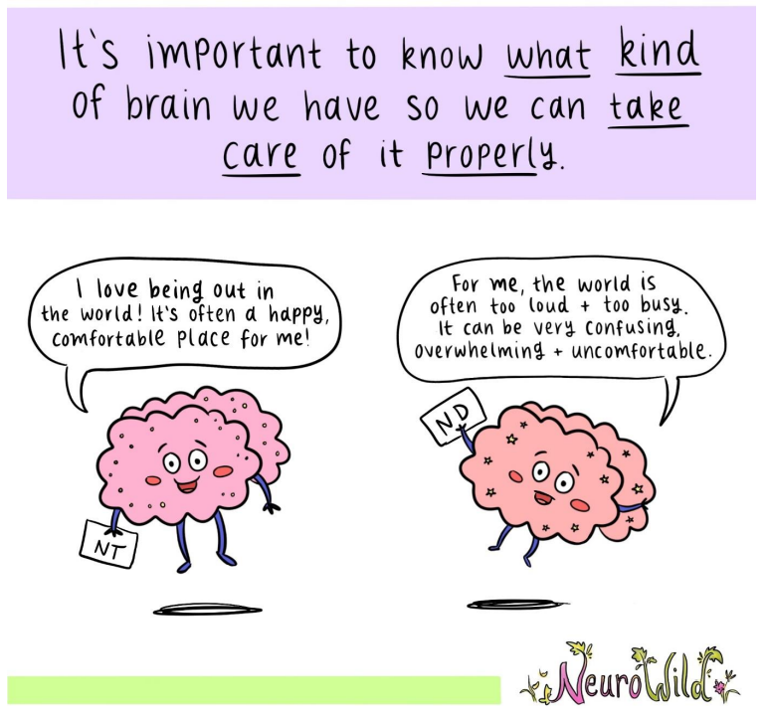
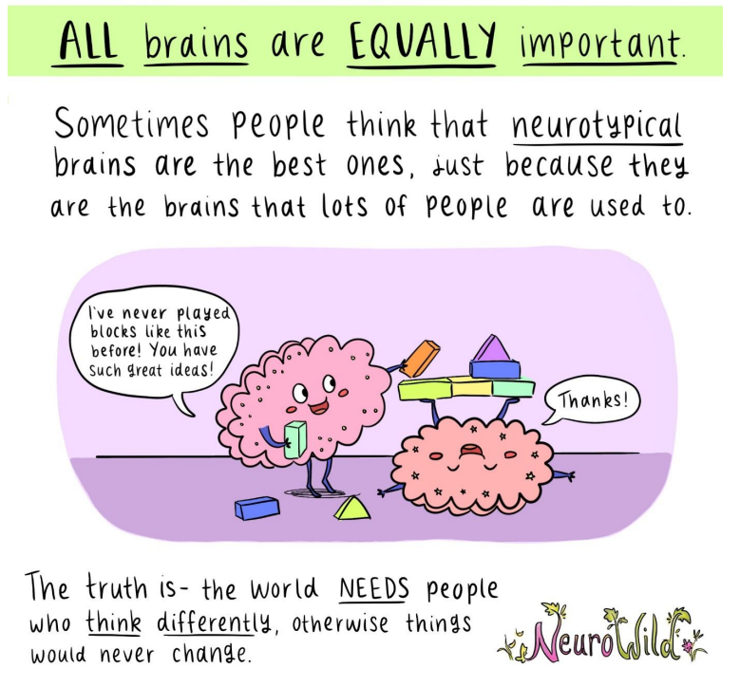
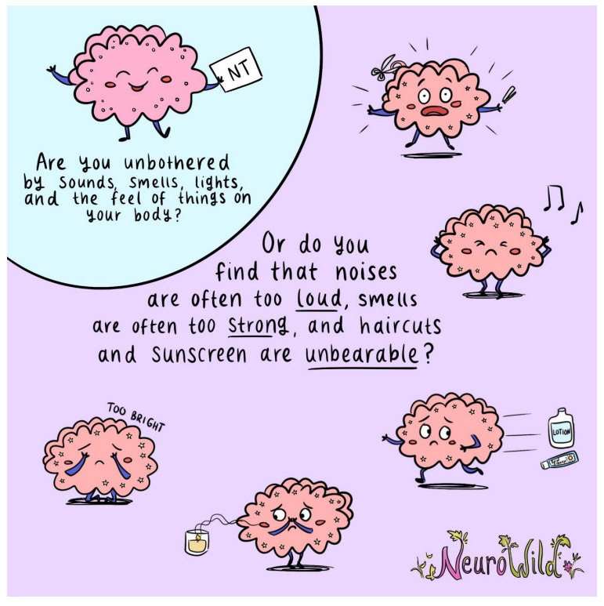
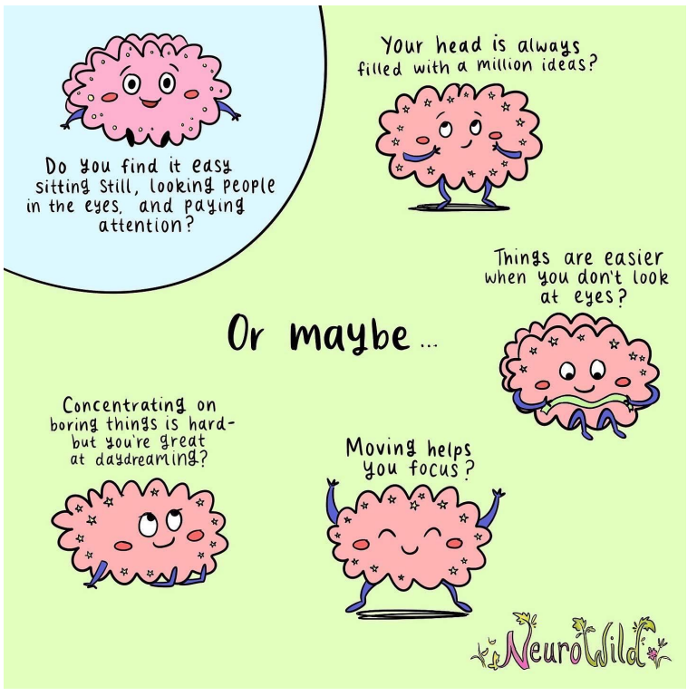
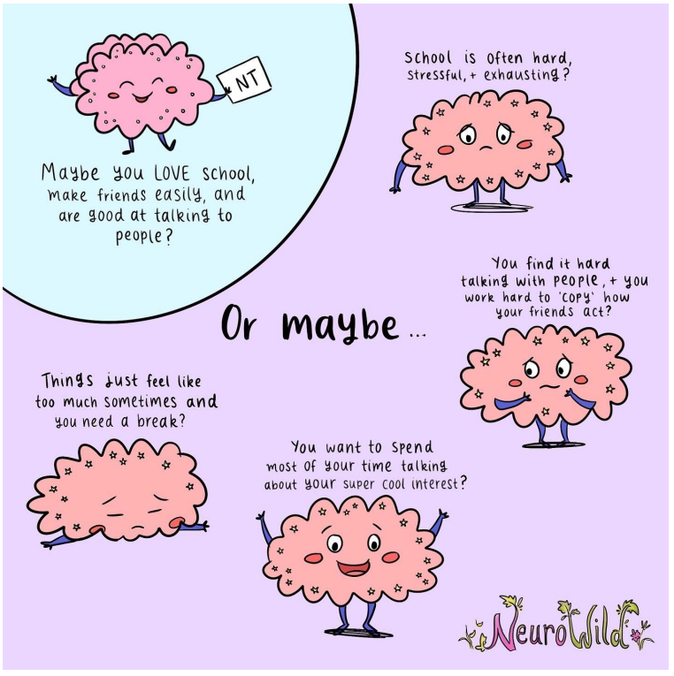
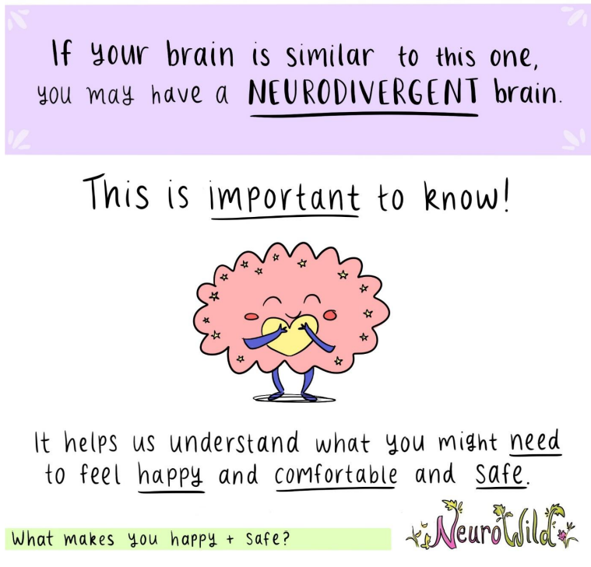
Why label…?

Slide 5
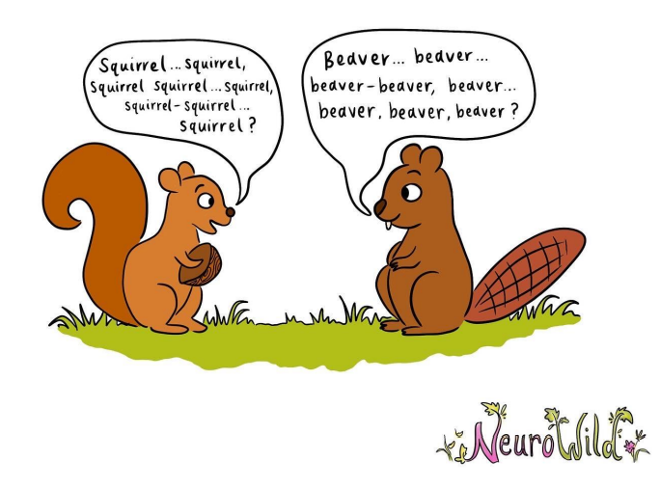
Differences in communication – the double empathy problem
Problems can occur when one person communicates one way and another person communicates in another way.
Despite what society tells us, this is not the ‘fault’ of the neurodivergent person.
How can we help?
Recognise the fact that neurodivergent people ARE communicating, they may just be doing it in a different way.
Do not blame the neurodivergent person for the misunderstanding.
Teach ALL children that communication is a 2 way street and we have to try to understand different forms of communication.
Normalise different forms of communication i.e. signing, picture cards, AAC devices etc.
Try to provide opportunities for neurodivergent children to be around other neurodivergent children.

Slide 6



All behaviour is communication…
What are they finding hard?
What could they be trying to tell you?
How do you communicate with them?
Say less
Stress the key words
Go slowly (wait 7-10 seconds)
Show what you mean

Slide 7
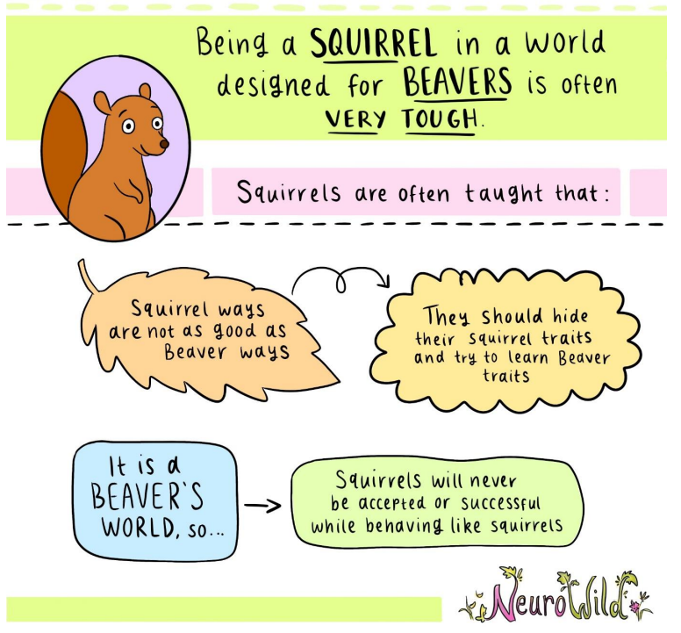
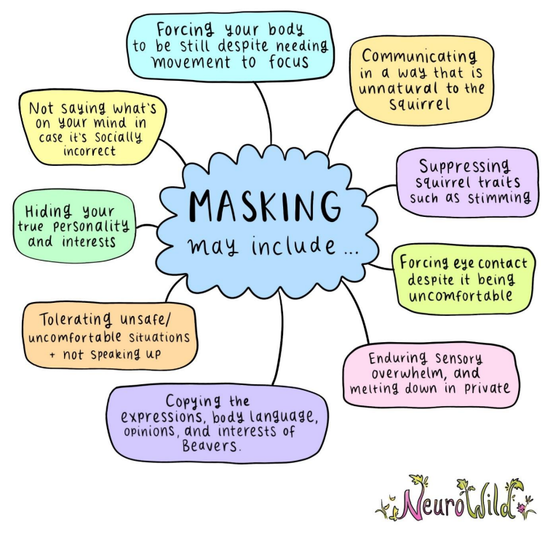
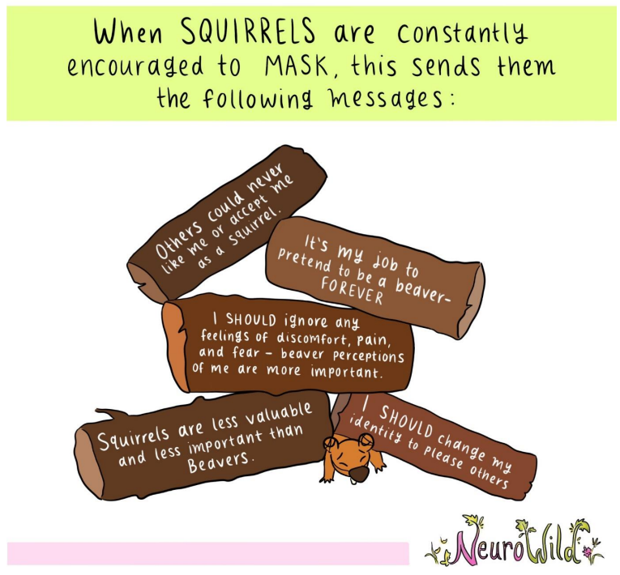
But they don’t look autistic/like they have ADHD/dyslexic etc…

Slide 8
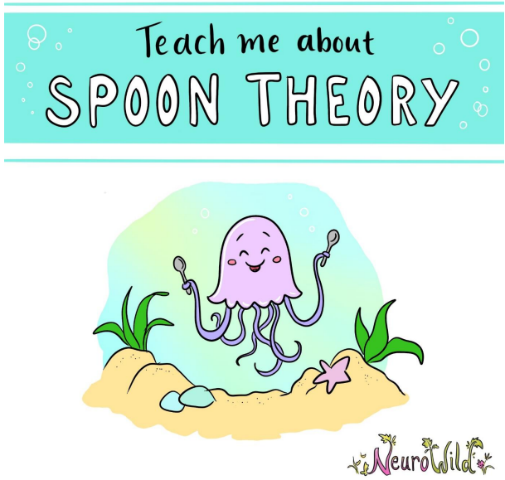
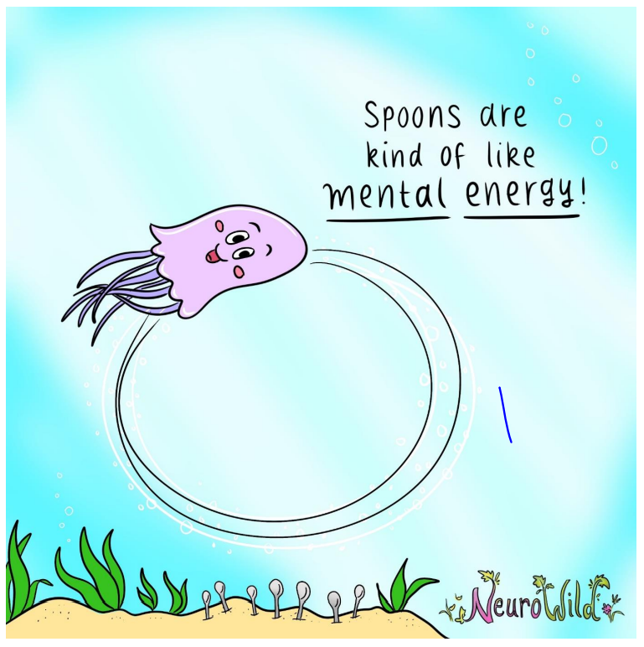
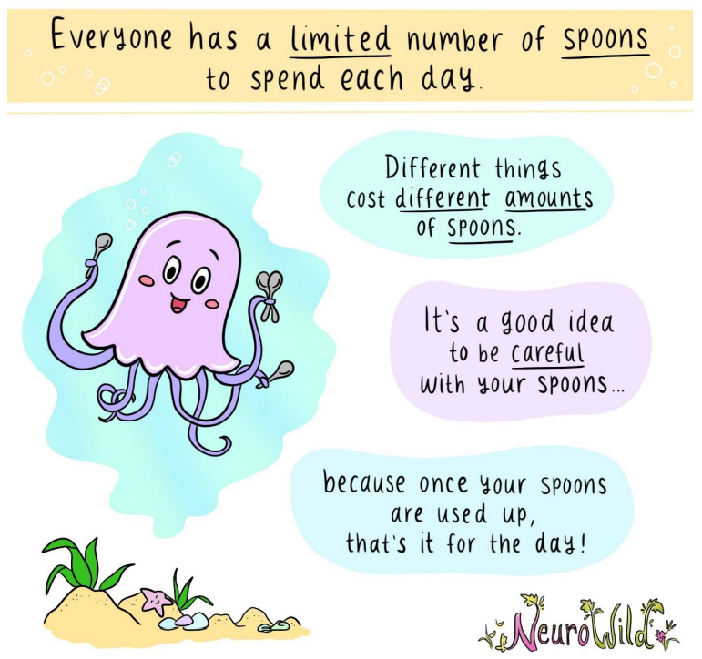
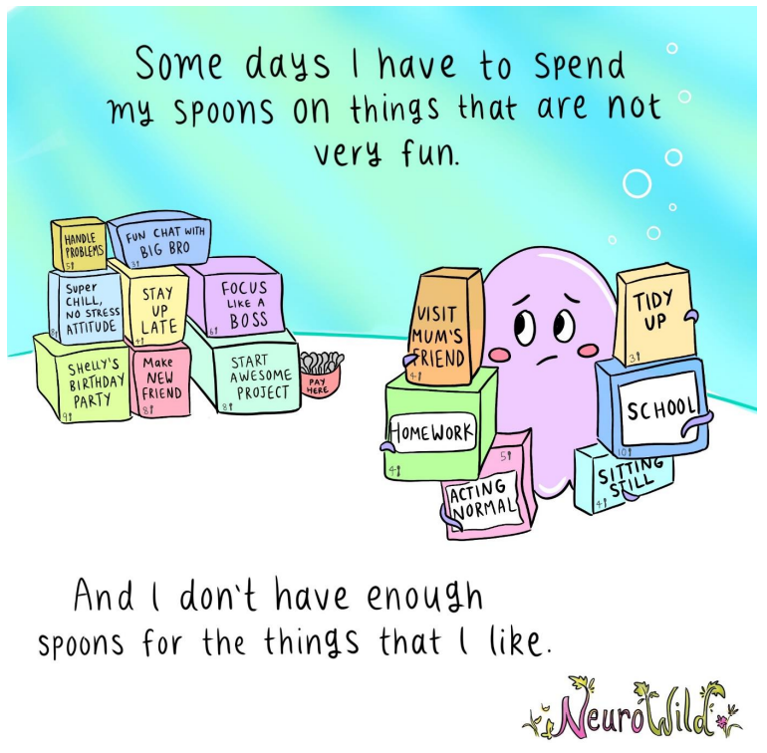
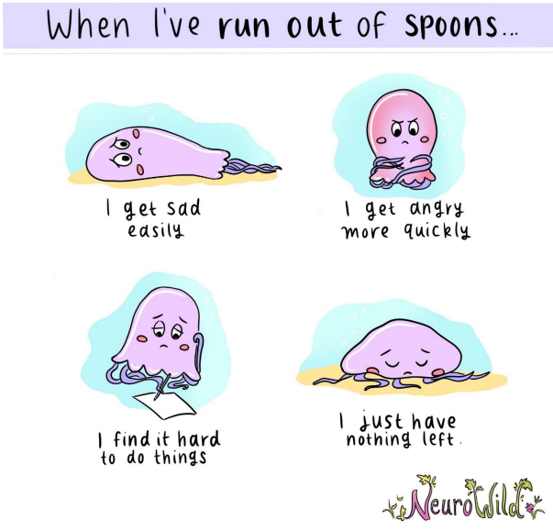
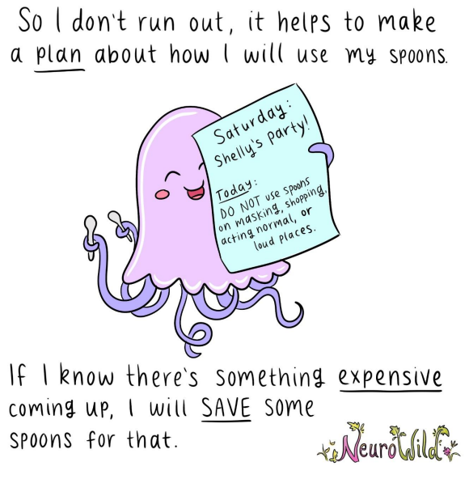
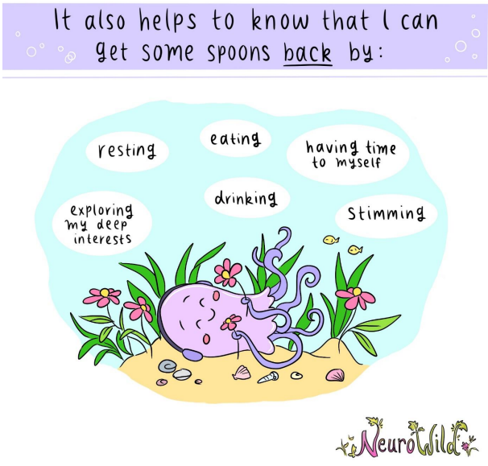
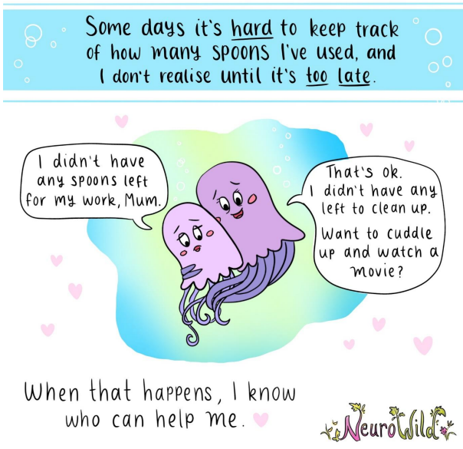

Slide 9
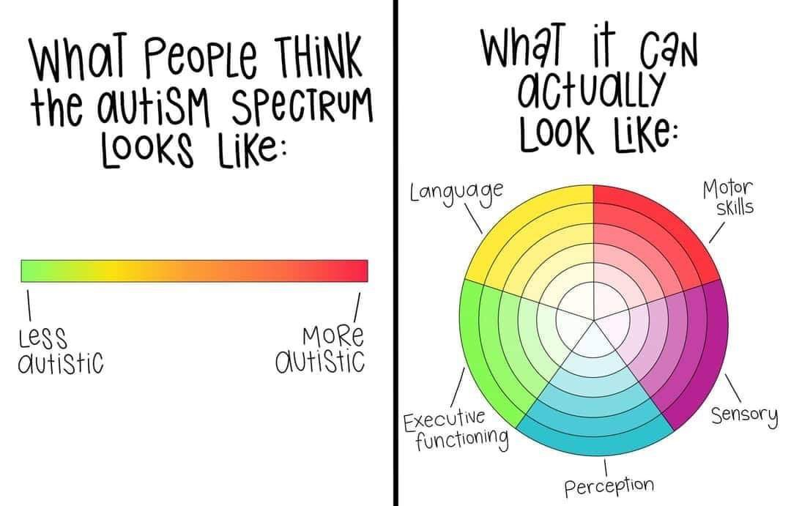
Autism
https://youtu.be/A1AUdaH-EPM
Autism IS a disability but only because the world is not designed for autistic people.
Notes:
There is no such thing as more/less autistic. How do YOU experience their autism?

Slide 10
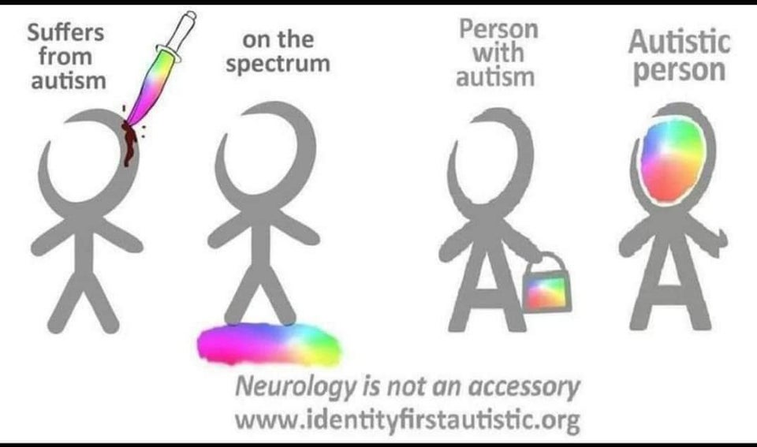
Language is important
Respect the language used by the person, however…

Slide 11
Top tips for supporting neurodivergent children
(not all will work for all – like all children, neurodivergent children are ALL different.
Make these part of your everyday parenting. | Positively encourage these things when you’re child becomes bubbly. | Try and avoid but know it WILL happen and be prepared.
Visual timetables. Now and next board. Verbal reminders. Emotional check ins. Predictable routine – forewarning when unexpected changes happen. Adaptations for sensory needs (ear defenders, minimal background noise, minimalist displays etc.) make this specific to them! Clear expectations – repeat before time of disruption. Pre-teaching (vocab, skills). 1-1 time with each parents. Sensory diet. Fidget toys. Visuals to reinforce expectations (using their photo if possible) Timer (if appropriate). Collaborative problem solving/active listening. | Chill out space – model how to use this e.g. ‘This is starting to make me a bit frustrated so I’m just going to have a chill for a minute then I’ll come and have another try.’ Doodle pad. Movement breaks. Distraction. Pick your battles i.e. does it matter if they eat in front of the tv? Validate feelings e.g. ‘I can see you’re angry. It’s ok to be angry. What can we do with that angry feeling?’ Offer alternative, safe, ways to express negative emotions i.e. stamping feet, squeezing a pillow, shouting in to a pillow. | Keep words to a minimum. Keep everyone safe but let it run its course. Calm voice. Be with them in that moment and reassure them that you are there for them when they need you. Tag out! Repeat to yourself – They are not GIVING me a hard time, they are HAVING a hard time. Remember, it is NOT about you – no matter how personal they get. When calmed: Offer comfort – meltdowns are exhausting! Reflect on when things escalated.

Slide 12
Acceptance
What DO we need to support these children with?
What can we accept to be a difference?
Eye contact – do not force or expect eye contact.
Playing alone – if a child is truly happy playing alone, allow them to do this.
Stimming – encourage free stimming (unless their stim harms themselves or other, in which case seek support for redirecting.)
Are Social Skills ‘Deficits’ an inherent part of Autism? Or, do both Autistic & Neurotypical people need to learn how to socialize with each other?

Slide 13
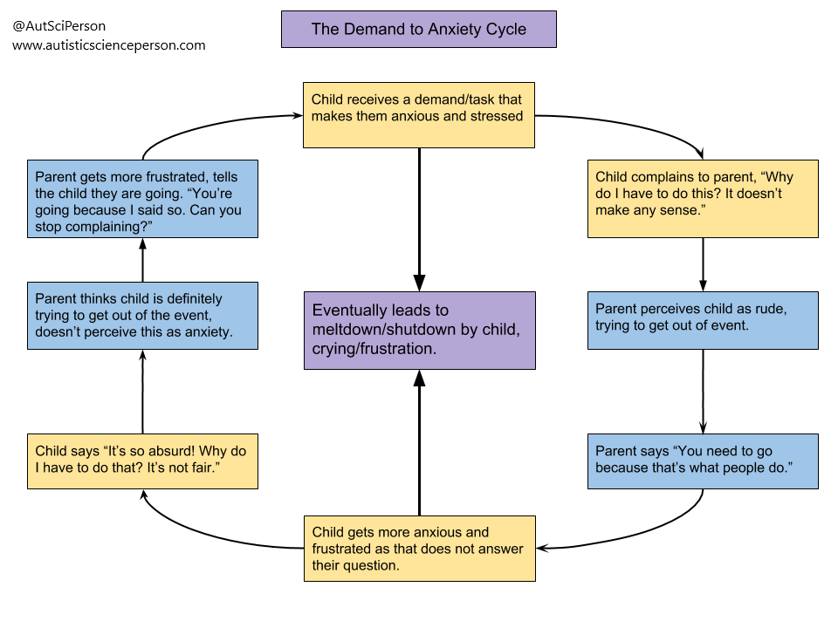

Slide 14
Where to go if you want to learn more:
Facebook page : Autistic not Weird
Facebook page : Neurowild
Facebook group : ‘Autism Inclusivity’
Use the #actuallyautistic when searching social media
Autistic Self Advocacy Network
Autistic Village – It takes a village to raise a child (autistic-village.com)
Ask About Autism
Hampshire Parent Carer Network (HPCN)
Autistic Girls Network
Chris Packham BBC series – Inside our Autistic minds

Slide 15


