Slide 1
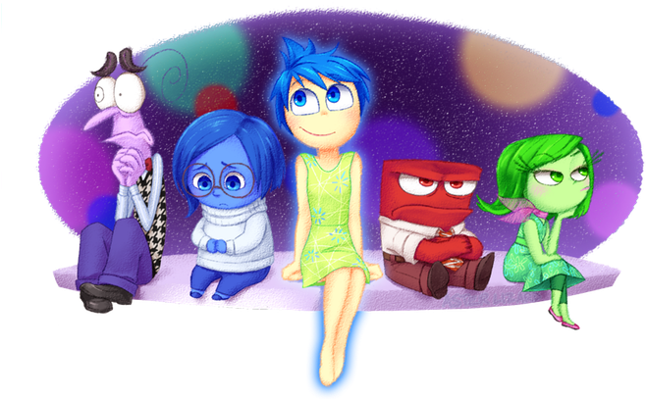
Books we are enjoying
Super Duper You by Sophy Henn
The Yellow Bag (Literacy Shed)
My Beautiful Voice
Computing
Online Safety
How to search
Science
Healthy Eating
Exercise
RHEd
My Happy Mind –
Meet the Brain
Exploring Families
Inside Out
Year 2 Autumn 1
PE
Fundamental Movement Skills – throwing and passing and receiving.
Yoga
Art
Pop Art
Looking at the artist Romero Britto.
Music
Questions and Answers
Learning about timbre and question and answer phrases.
RE
Symbols
Why are they important to Christians and Hindus?

