Slide 1

Welcome to
Kempshott Infant School
Notes:
Nicola

Slide 2
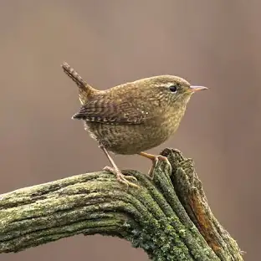
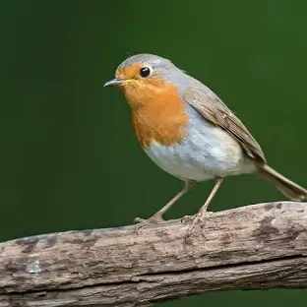
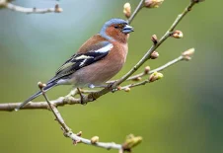
Meet the adults in Year R
Wren Class
Class teacher: Miss Moses
Learning Support Assistant: Mrs Harding and Mrs Perkins
Robin Class
Class teacher: Mrs Moore
Learning Support Assistant : Mrs Briggs
Chaffinch Class
Class teacher: Mrs Jeffery
Learning Support Assistant : Mrs Joyce

Slide 3
School Timings – a typical day
8.35 a.m. Doors open
8.45 a.m. Doors close for registration
9.00 – 10.20 a.m. First morning session - English
10.20 – 10.40 a.m. Fruit/Milk
10.40 – 10.55 a.m. Playtime
10.55 – 11.45 a.m. Second morning session - Maths
11.45 – 1.10 p.m. Lunchtime
1.10 – 2.45 p.m. Afternoon session
2.45 – 2.55 p.m. Playtime
2.55 – 3.15 p.m. Story time
3.15 p.m. Home time
Notes:
Claire
Entrance doors are on the Year R playground.
Enter through the door to your child’s class.
Staff are on the door to take any messages in the morning.
Please encourage your child to go in independently.
Claire
Playtimes – to begin with Year R have an area of the main playground coned off to play in.
Lunchtime – Year R eat in their classroom.
End of the day – children leave via their classroom door.
Children will only be handed over to people listed on Arbor.

Slide 4




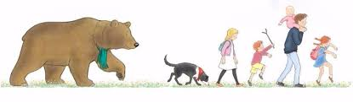
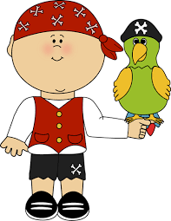
Topics in Year R
Autumn 1 – All About Me
Autumn 2 – Awesome Autumn
Spring 1 – People Who Help Us
Spring 2 – Let’s Grow
Summer 1 – Bears, Bears, Bears
Summer 2 – Pirates and Under the Sea

Slide 5
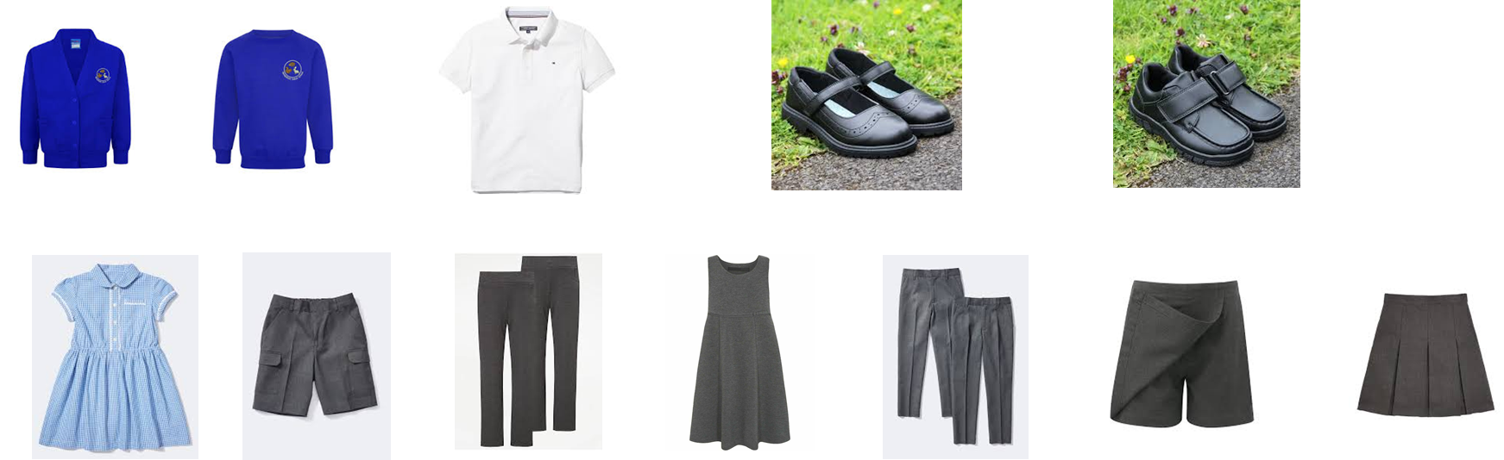
School uniform
Our school colours are royal blue and grey and our uniform consists of:
A royal blue sweatshirt or royal blue cardigan embroidered with the school's logo, which can be purchased from Skoolkit.
Skirts, culottes, trousers, pinafores or shorts are grey. In the warmer weather a light blue and white gingham summer dress/playsuit may be worn.
White short sleeved polo shirt to be worn under the sweatshirt or cardigan.
Socks and tights should be black, grey or white.
Shoes should be sturdy and appropriate to run around and play in.

Slide 6
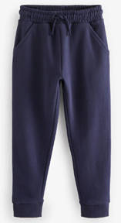
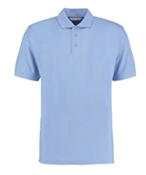
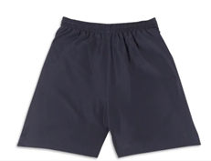
P.E Clothing
Your child will need:
Pale blue polo shirt.
Dark blue shorts, cycling shorts or skort. Dark blue jogging bottoms can be worn in the colder weather.
Trainers or plimsolls
School jumper/cardigan

Slide 7
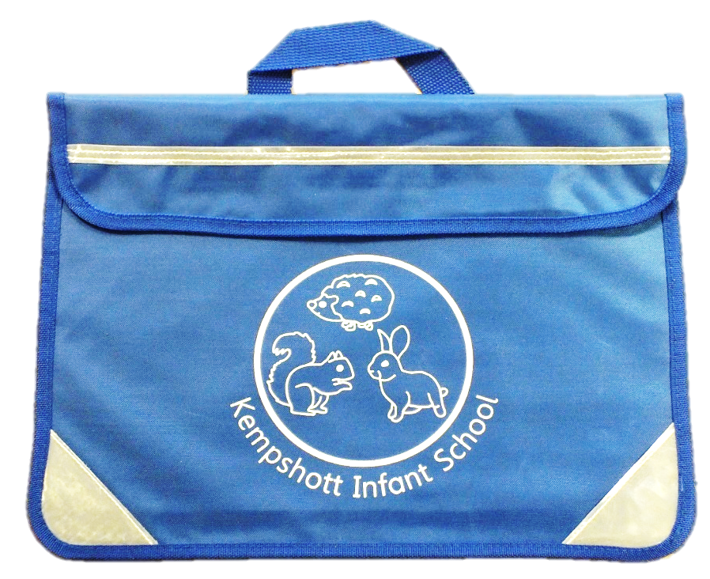
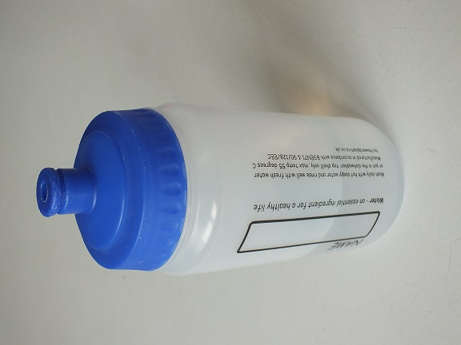
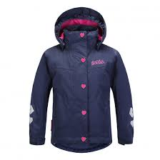

First Day
Your child will need:
Book bag
Water bottle
Rain coat/sun hat
Notes:
Claire
Book bags and water bottles will be on sale at the Triangle meetings and are available from the school office. Book bag £4 Bottles £1.00 from September £1.20 replacement lids 30p
Wellies need to stay in school as the children go on regular welly walks around the school grounds.
PE bags – please can these be simple draw string bags with your child’s name on. No rucksacks please.

Slide 8
Important Dates
2nd July - Group A Stay & Play - 1.45-2.45pm
9th July - Group B Stay & Play 1.45-2.45pm
Wednesday 2nd September, Thursday 3rd September – Parent Teacher Meetings
Friday 4th September – 1 hour Transition Sessions
Monday 7th September – 1 hour Transition Sessions
Tuesday 8th September – School Starts!
Group A: 8.35– 10.30 a.m.
Group B: 1.15 – 3.15 p.m.
Wednesday 9th September
Group B: 8.35 – 10.30 a.m.
Group A: 1.15 – 3.15 p.m.
Thursday 10th September – All Year R children start full time.
Notes:
Claire explains stay and plays
Nicola starting school in September.

