Slide 1
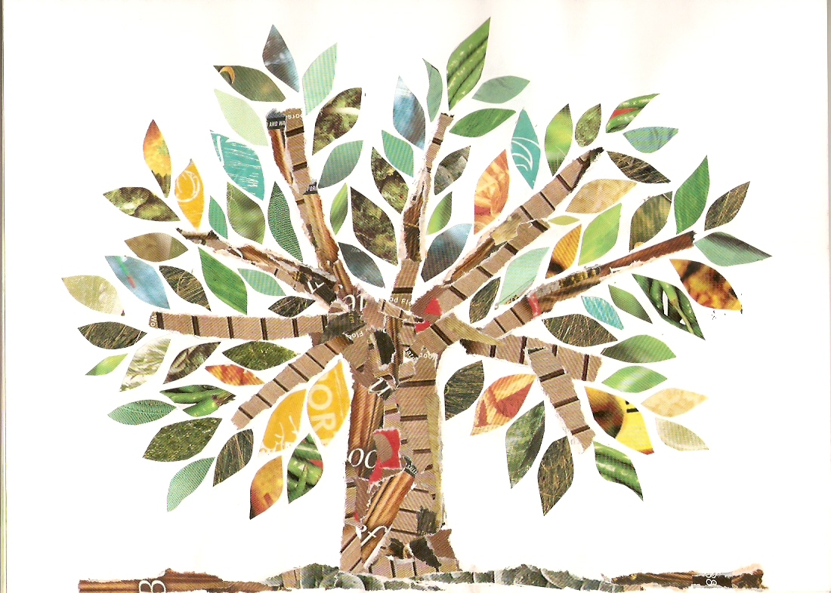
Books we are enjoying
Hoot Owl - Sean Taylor
Follow Me, Little Fox - Camila Correa
My Rice is Best – Selina Brown
Dotty Doughnut – Momoko Abe
Basil Dreams Big – Lu Fraser
Computing
Grouping and Sorting
Collecting data and creating pictograms
What is Technology?
Technology outside School
Science
Identify & describe the basic structure of plants and trees
Name common plants
Investigate how different seeds grow
My Happy Mind Engage Module
Understanding what it means to engage and why paying attention helps us to learn.
Setting goals and achieving them.
Keeping healthy
Fantastic Forests
Year 1 Summer 1
PE
Athletics
Gymnastics
Geography
Order months of the year and identify which season they are in.
Differences between the types of weather experienced in different seasons.
Art
Artist: Norval Morrisseau
Create a piece of artwork using colour, shape and black outlines in the style of Norval Morrisseau
Music
Explore Tempo
using body percussion and percussion instruments.
RE
Special books
What makes it special?
Special Christian books and stories

